Slide 1
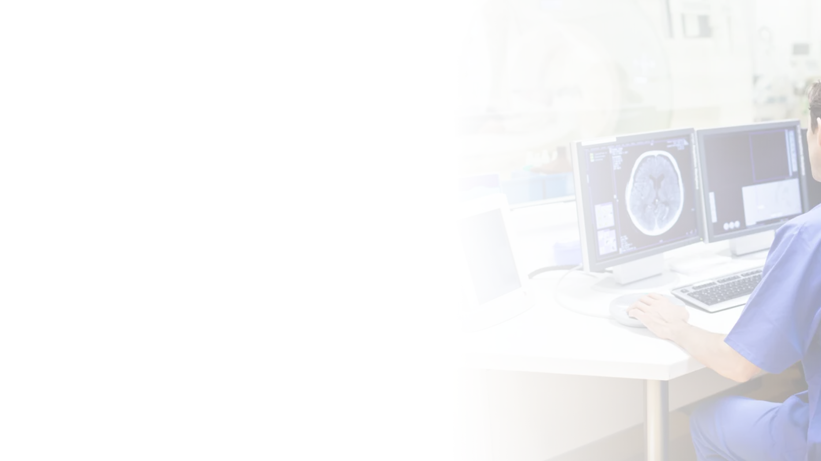



Company-Based Capstone Project 2024
Kalbe: Visual Question Answering for Medical Imaging
C24-RM01 | Advisor: Fadinda Shafira
Jihad
M002D4KY2344
Dera
M002D4KY1491
Rozaq
M002D4KY3337
Caleb
M002D4KY2570
Dafa
C012D4KY1160
Notes:
Hello, everyone.
Welcome to our presentation for the Bangkit Company-Based Capstone Project 2024. We are Team C24-RM01, and our project is titled "Kalbe: Visual Question Answering for Medical Imaging." This project is supervised by our advisor, Fadinda Shafira.
In the next 10 minutes, me (Jihad from ML, and Dera from ML, Rozaq from ML, Caleb from ML, and the last one is Dafa from Cloud Computing) will be presenting what we've been working on.

Slide 2
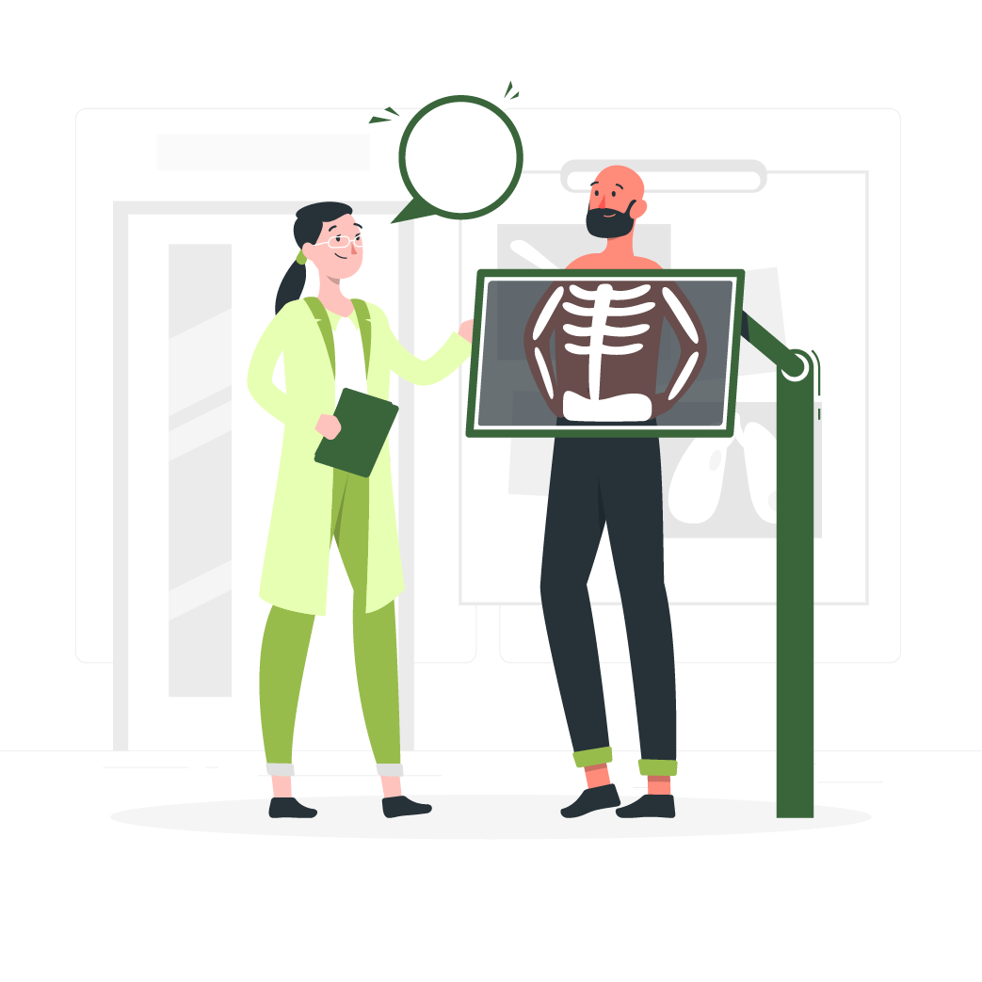
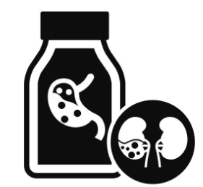

Background
C24-RM01
VQA for Medical Imaging
1
In the field of healthcare, achieving precise and efficient medical imaging analysis is crucial. While current methods are effective, they heavily rely on specialist doctors (radiologists), leading to potential delays and inaccuracies due to human error.
Study shows error rates in radiology diagnosis can range from 10-30% (Brady A.P., 2017). These errors can have significant downstream consequences for patient outcomes.
The growing demand for analysis also outpaces the number of qualified radiologists (Goh & Ho, 2023).
The introduction of advanced AI models such as Visual Question Answering (VQA) in medical imaging promises a revolution in analyzing medical images quickly and accurately, reducing human error and workload for radiologists.
Seeing this case from Kalbe Farma company expose makes us interested in developing Medical Imaging VQA models to increase effectiveness of healthcare professionals' performance.
Notes:
To start with, medical imaging plays a crucial role in healthcare for diagnosing and monitoring patients. However, the process of interpreting these images is time-consuming and requires expertise. Our project aims to address this challenge by developing an AI model that can assist healthcare professionals in analyzing medical images quickly and accurately, reducing human error and workload for radiologists.

Slide 3
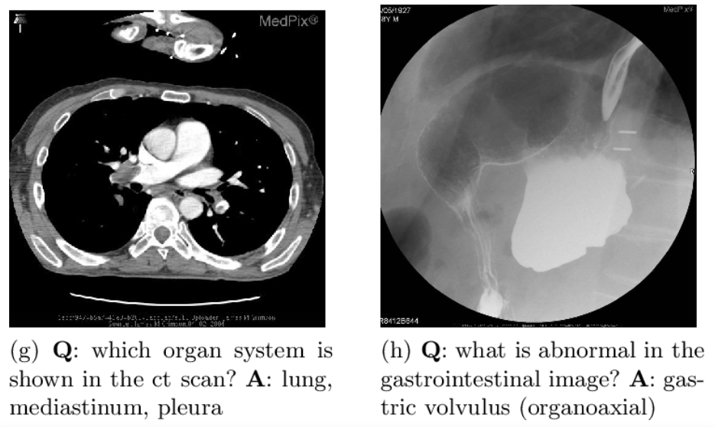


Reasons
C24-RM01
VQA for Medical Imaging
2
However, existing healthcare systems lack technical expertise, require large high-quality datasets, and need IT infrastructure compatibility.
From this problem a question arises, how to develop advanced AI models (VQA) that help professional healthcare analyze medical imaging?
Creating implementable medical VQA models that complement radiologists' expertise and deploying them on a user-friendly website.
This goal will make our project readily accessible and implementable within existing healthcare systems. This medical VQA model will help healthcare professionals' in interpreting medical images and reducing the likelihood of misdiagnosis.
Notes:
Why did you choose the theme and such a problem statement?
What kind of problems do you want to tackle?

Slide 4
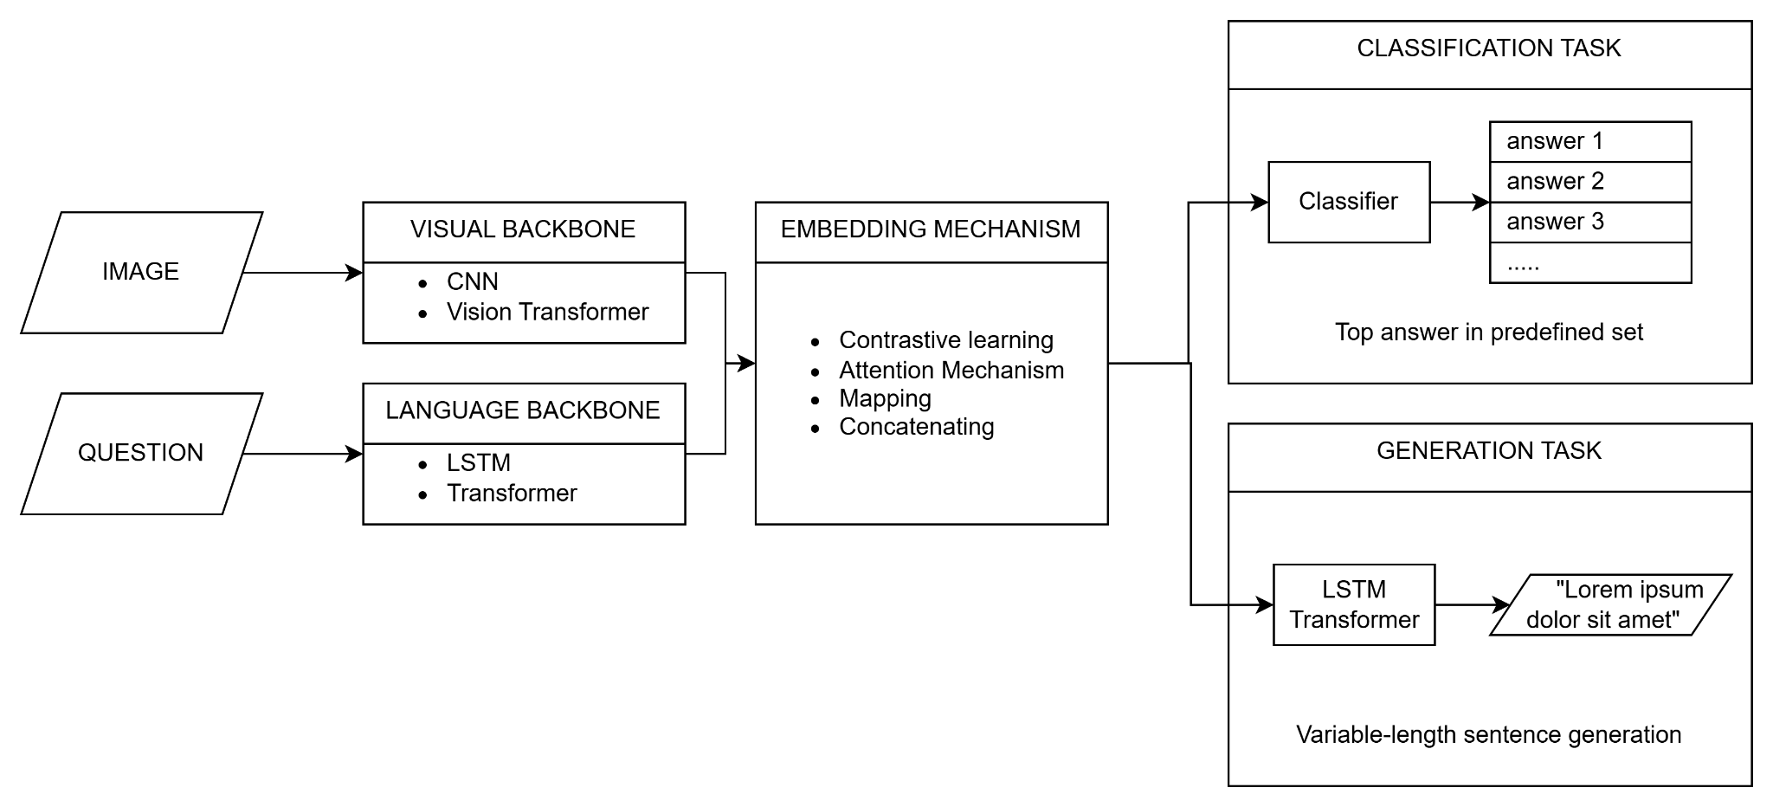
Existing Solution: General VQA Architecture
C24-RM01
VQA for Medical Imaging
3
We need to fine-tune our model to extract features from medical images and questions, combine these features, and generate the appropriate answers. To achieve this, we will select some of the pre-trained transformer-based models available on Hugging Face or Github.
Notes:
So far, are there any studies/efforts from other people that want to solve similar problems?
What are the missing elements that you can identify?
In this slide we will discuss about general VQA Architecture. This is the outlines of general VQA architecture that processes images and questions to generate accurate answers.
There are several missing elements that the general VQA doesnt have which is a domain-Specific training in:
Fine-Tuning on Medical Data: Most existing models are pre-trained on general datasets and might not perform optimally on medical images without extensive fine-tuning.
Limited Medical Datasets: There are fewer publicly available datasets specifically for medical VQA, limiting the training and evaluation of models.
In this architecture, there are two inputs which is:
Image: The visual content we need to analyze.
Question: The related query that needs answering.
Processing: We have two backbones for processing these inputs:
Visual Backbone: Uses CNN and Vision Transformers to extract features from images.
Language Backbone: Uses LSTM and Transformers to understand the question.
And then we combine this features in which the extracted features are then combined through:
Embedding Mechanism: Using techniques like Contrastive Learning, Attention Mechanisms, and feature concatenation.
And then the combined features are used for two tasks:
Classification Task: A classifier selects the top answer from a predefined set.
Generation Task: An LSTM or Transformer generates a descriptive answer.
In that case, we need to fine-tune our model to extract features from medical images and questions, combine these features, and generate the appropriate answers. To achieve this, we will select some of the pre-trained transformer-based models available on Hugging Face or Github.

Slide 5
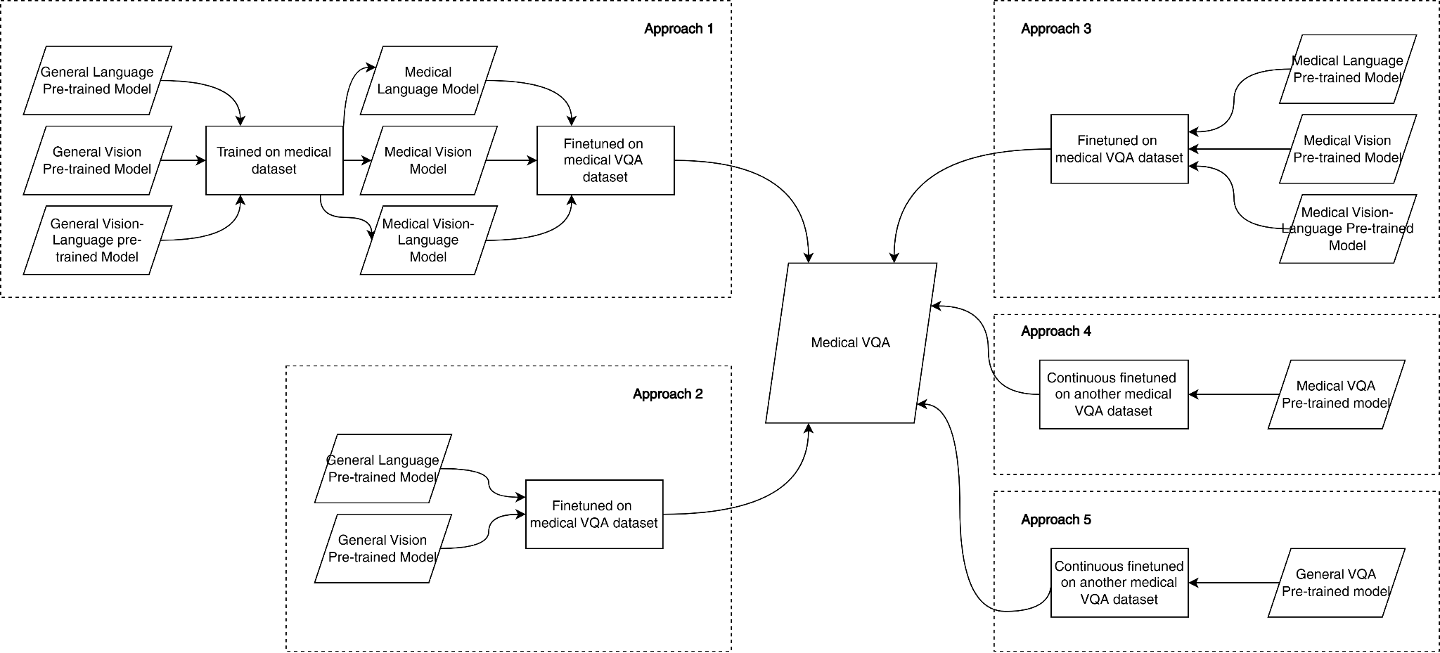
Existing Solution: Approaches
C24-RM01
VQA for Medical Imaging
4
We chose approaches 2 and 5 because of the possibility and availability of open-source datasets and pre-trained models.
This two approaches
also doesn’t have a pre-trained model on medical VQA task

Slide 6

Our Solution:
General Workflow
C24-RM01
VQA for Medical Imaging
5
We plan to develop a Medical VQA Model with an architecture similar to a general VQA model, with visual and text encoders for feature extraction. There are several flows in our workflow, namely data collecting, dataset pre-processing, ML model training, and deployment.
Data Collecting
Data Pre-processing
ML Model Training
Model Deployment
Open-source Radiology Dataset
Data Cleaning
Approach 2
Cloud Server
Build Medical VQA model from separate vision and language model
Hugging Face Spaces
Data Formatting
VQA-RAD
SLAKE
ROCO
Approach 5
GUI Framework (Web)
Dataset Uploading to
Hugging Face
Fine-tune Large Multimodal / VQA pre-trained model
Gradio
Notes:
based on existing solution we developed medical vqa model with an architecture similar to a general VQA model and here are our general workflow solution : first data collecting, we look for open source medical dataset for vqa task (vqa rad, slake, and roco), the second is data pre-processing (consist of data cleaning, formatting, and upload to hugigngface), the third is ML model training, and the last one is model deployment to cloud.

Slide 7
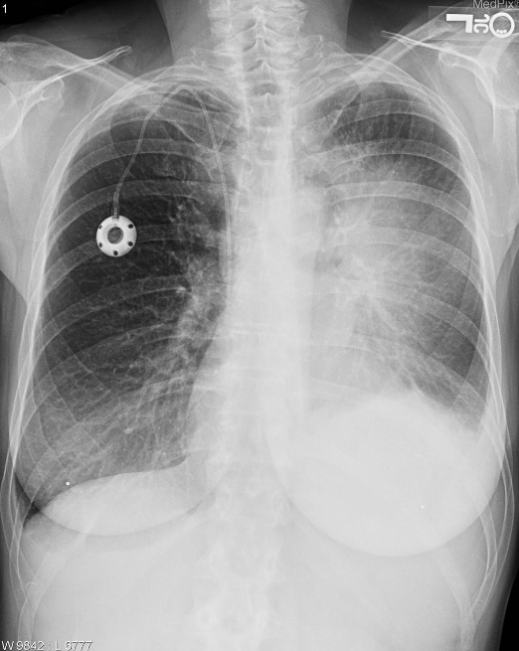
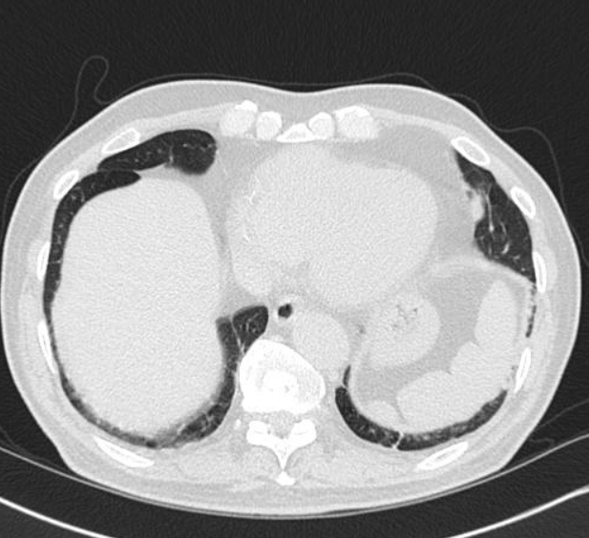
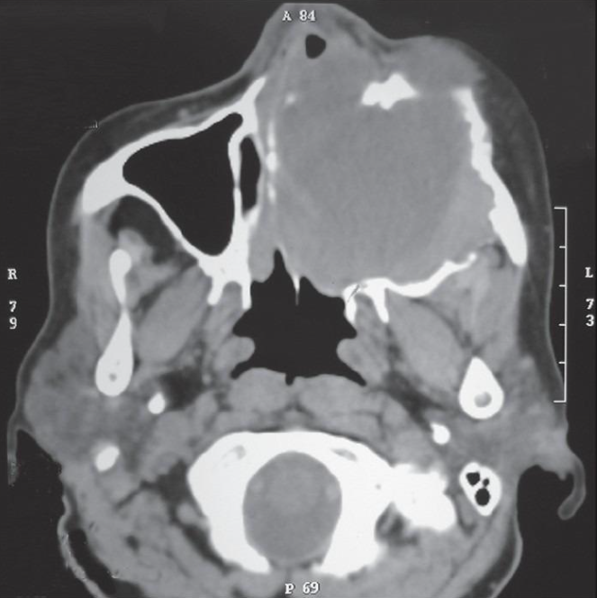
Our Solution:
Data Collecting and Pre-processing
C24-RM01
VQA for Medical Imaging
5
C24-RM01
VQA for Medical Imaging
6
Dataset | Modality | Quantity |  | Example Dataset
 |  | Images | QA Pair
VQA-RAD | Radiology | 300 | 3,500
SLAKE | Radiology | 700 | 14,000
ROCO | Radiology | 81,770 (image caption pair)
Notes:
Here are our dataset for fine tuning medical vqa task. We take dataset vqa -rad, slake, and roco dataset that have modality in radiology

Slide 8
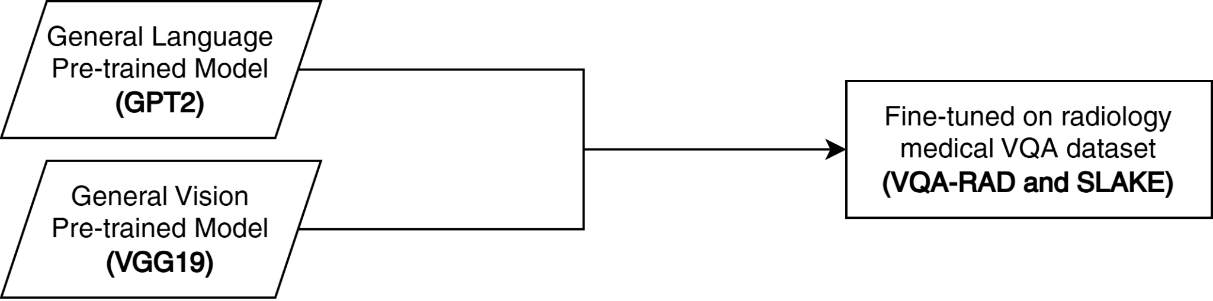
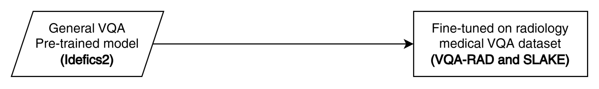
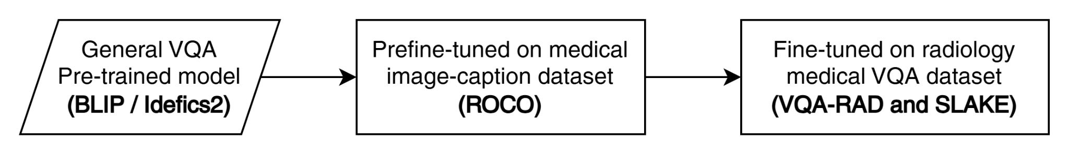
Our Solution:
ML Model Training
C24-RM01
VQA for Medical Imaging
7
Approach 2
Unimodal
Approach 5
Multimodal
Approach 5 (modify)
Multimodal
Notes:
For our model we have 2 approaches which is, unimodal and multimodal. For unimodal approach we combine gpt2 as language model and vgg19 as vision modell and then we combine it together as a visual language task. For multimodal approach we use idefics2 and blip and then fine tuning the model with medical vqa dataset that we’ve mentioned before.

Slide 9


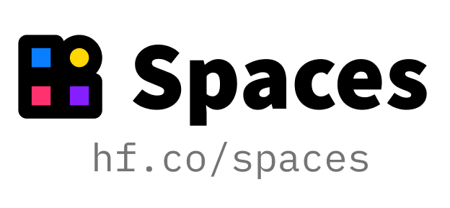

Our Solution:
Model Deployment
C24-RM01
VQA for Medical Imaging
8

Slide 10
Result:
ML Model Performance
C24-RM01
VQA for Medical Imaging
9
Pretrain Model | Prefine-tune Dataset | Accuracy
 |  | VQA-RAD | SLAKE
VGG-GPT2 | - | 27.72% | 28.09%
VGG-BioGPT | - | 33.26% | 27.24%
BLIP | - | 44.57% | 67.58%
Idecis2-8B | - | 53.22% | 76.26%
 | ROCO | 51.20% | 81.05%
Notes:
Result of the work, statistics, improvements, screenshots.

Slide 11
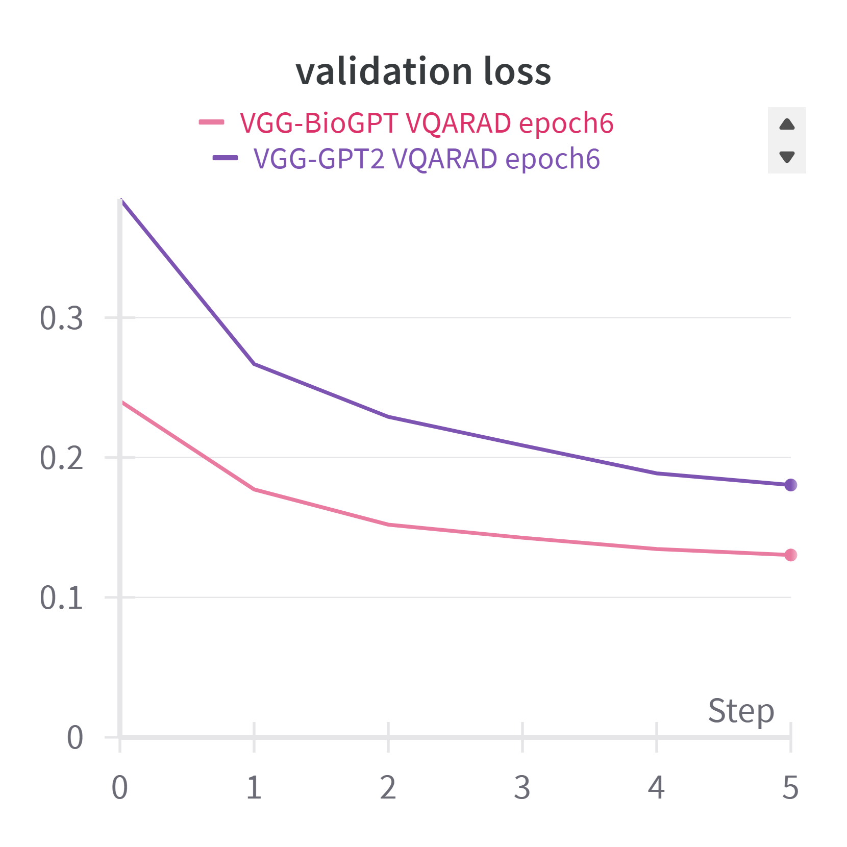
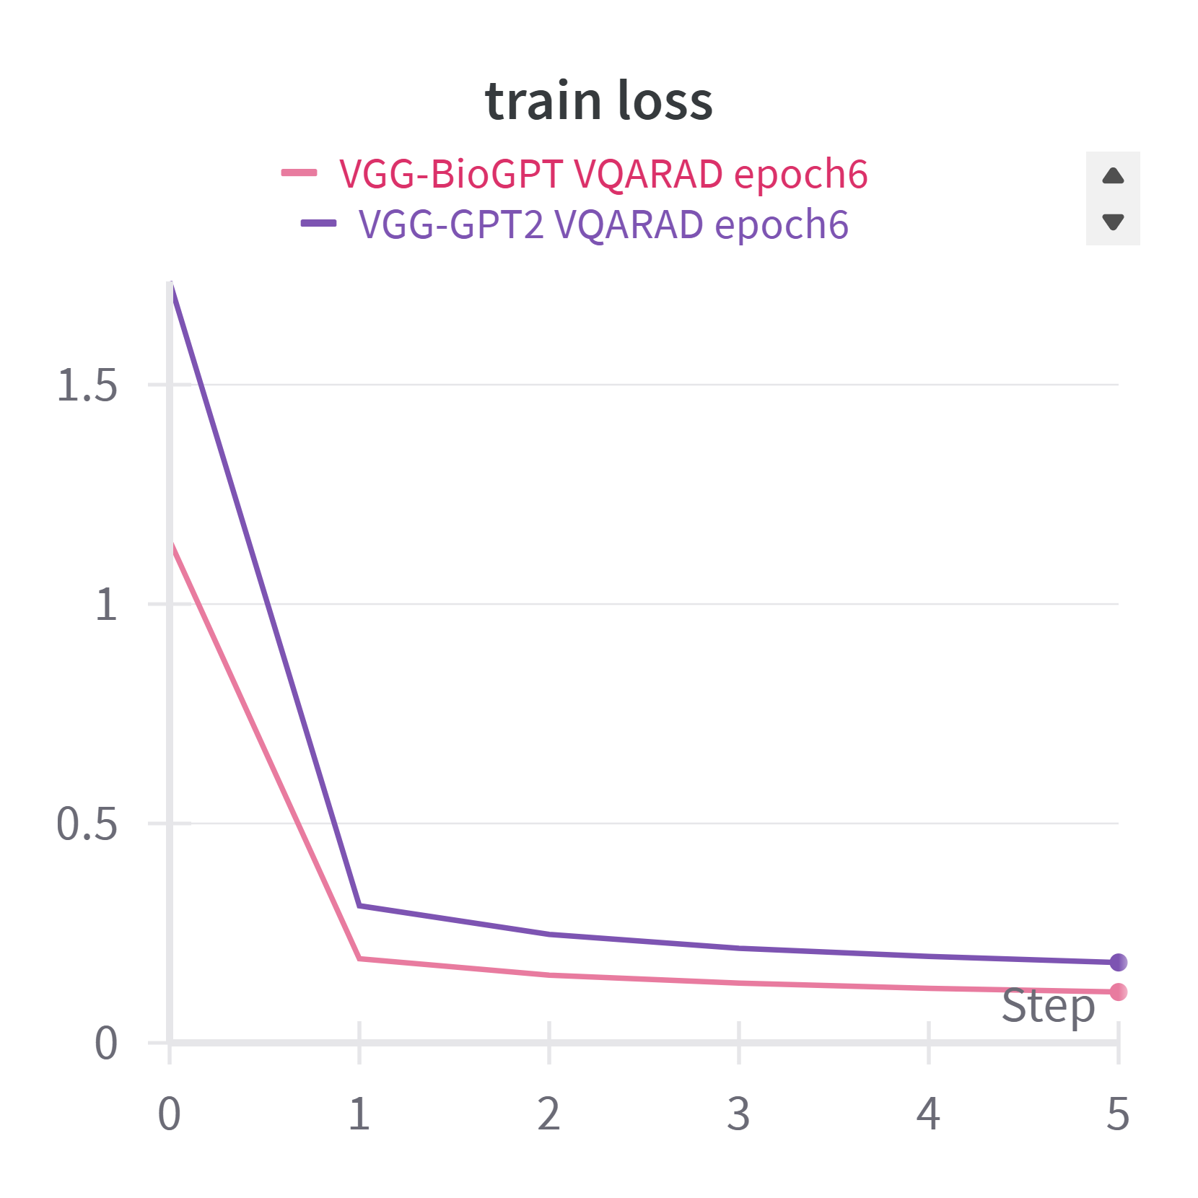
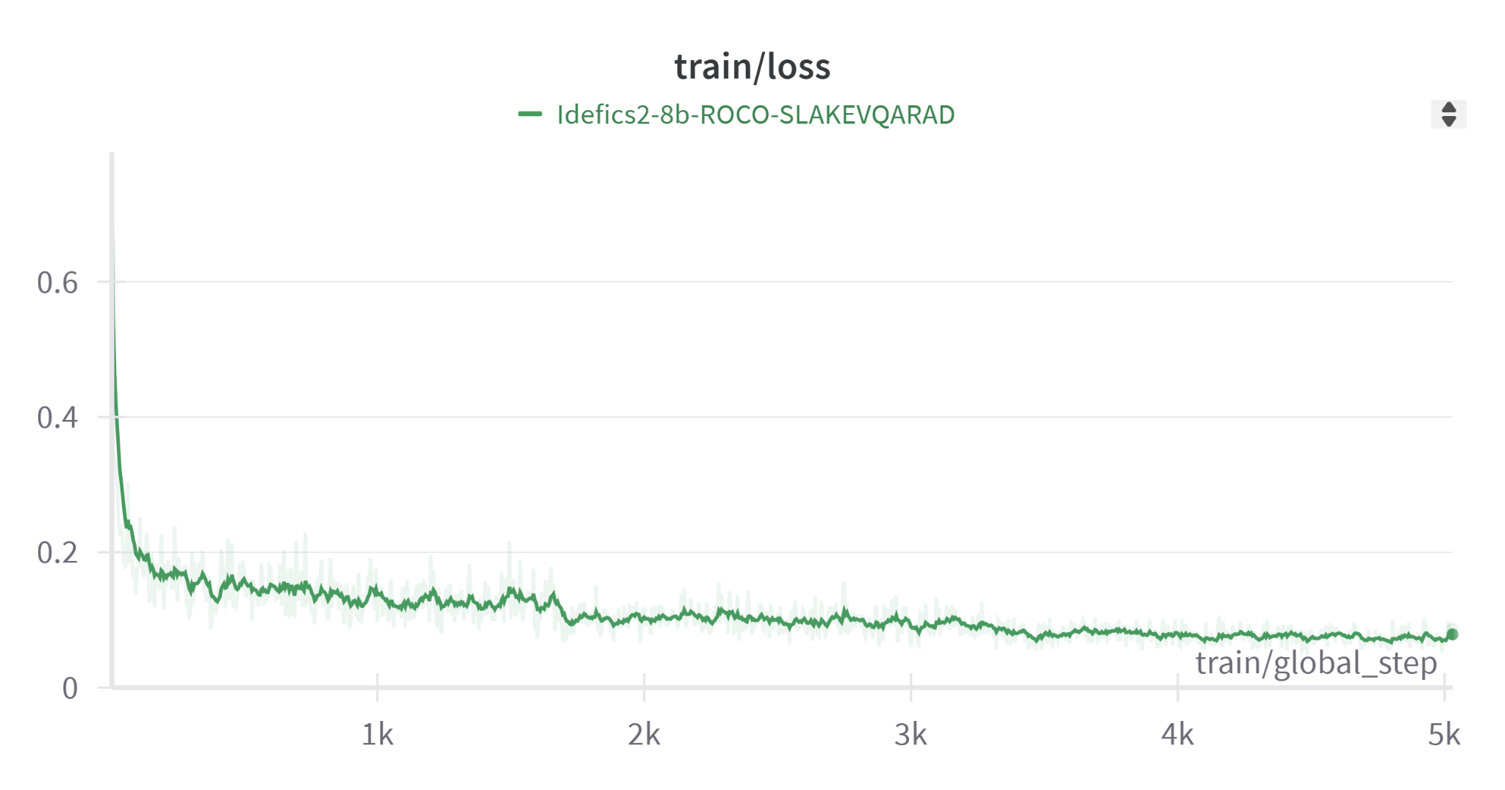
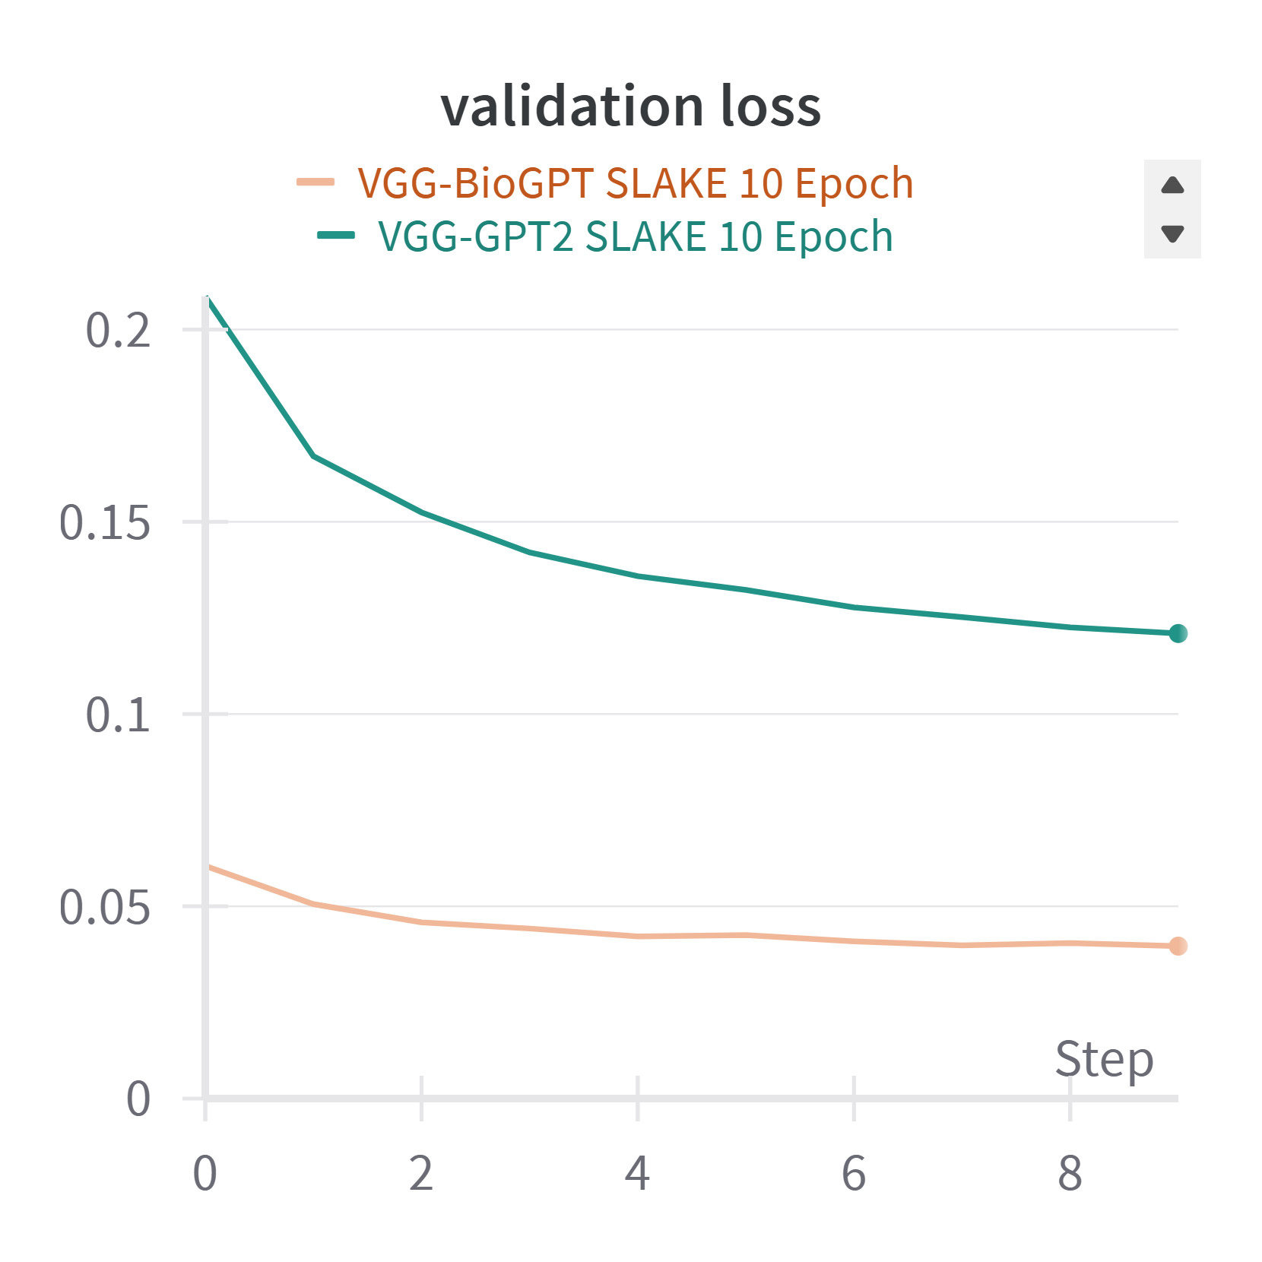
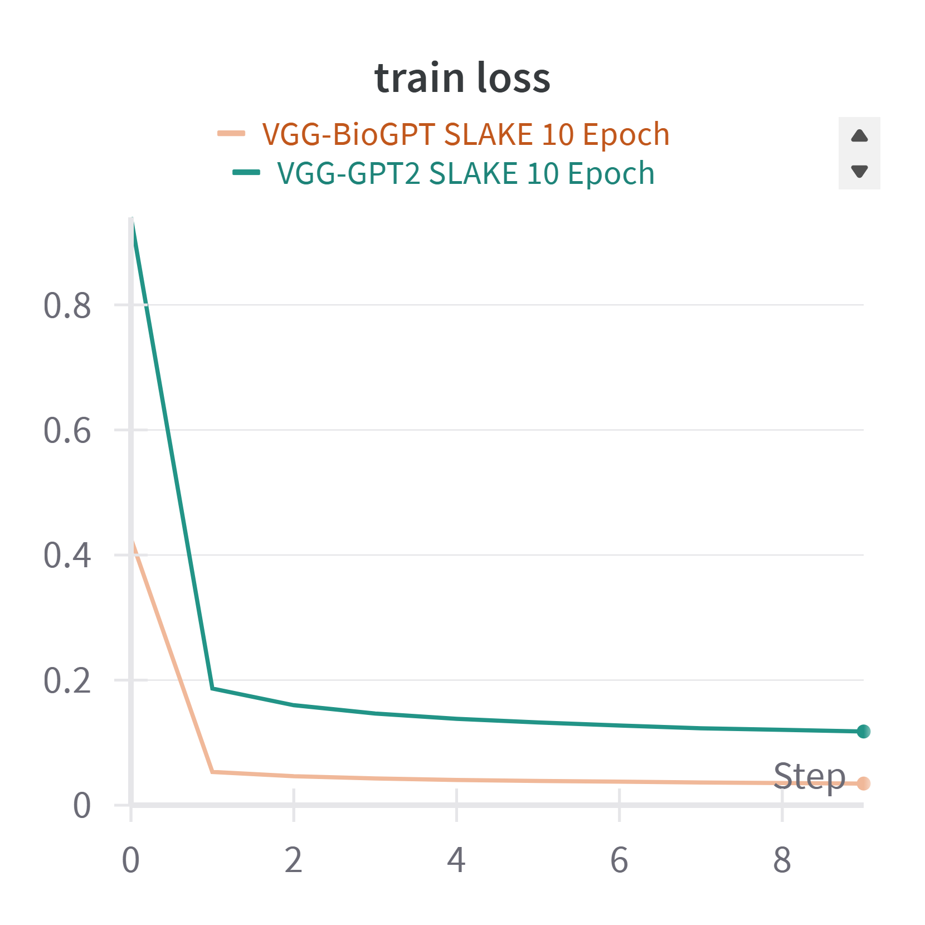
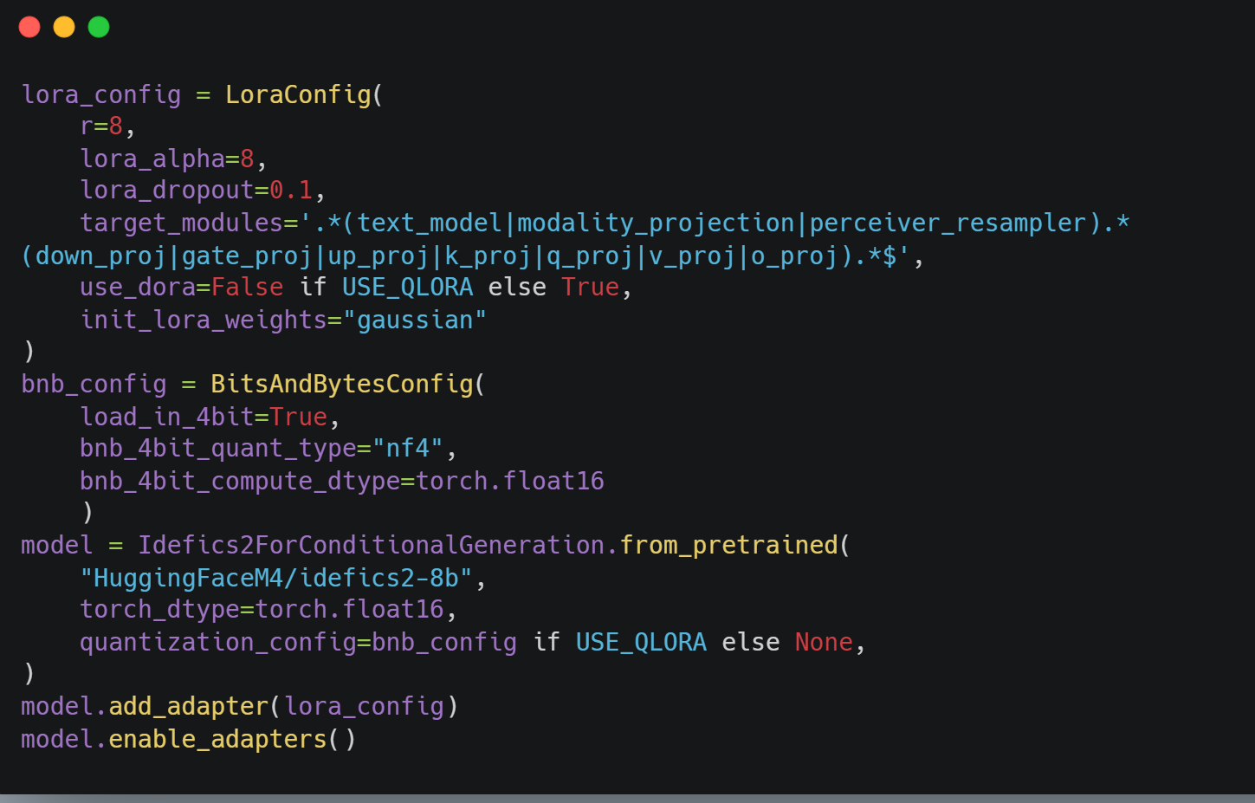
Result:
Training Snapshots
C24-RM01
VQA for Medical Imaging
10
Idefics2-8b-ROCO on combined VQA-RAD & SLAKE Dataset, fine-tuning with LoRA, PEFT, and quantization
VGG-GPT2/BioGPT on VQA-RAD Dataset
VGG-GPT2/BioGPT on SLAKE Dataset
Notes:
Result of the work, statistics, improvements, screenshots.

Slide 12
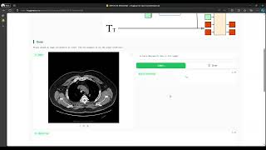
Result: Web Application Demo
C24-RM01
VQA for Medical Imaging
11
Demo Video Web App
Link Web App
Notes:
Result of the work, statistics, improvements, screenshots.

Slide 13
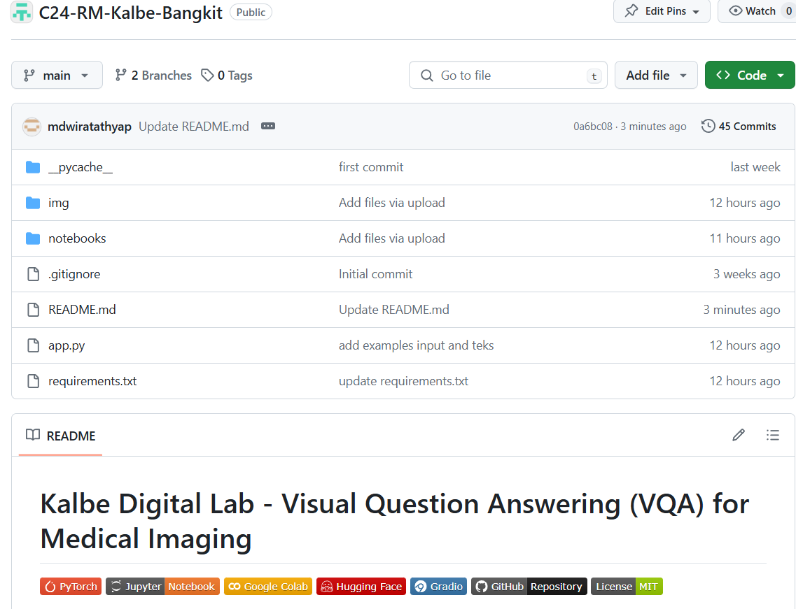
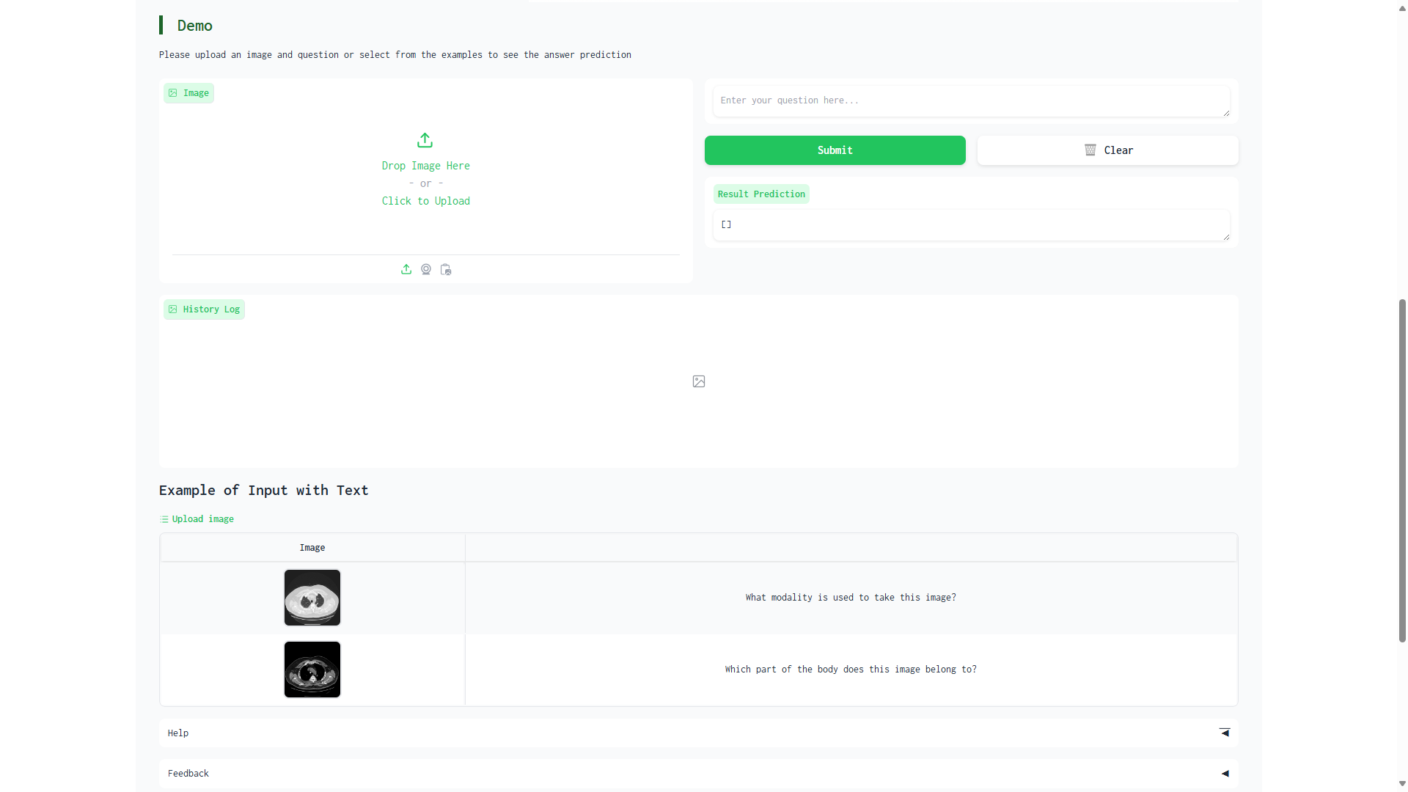
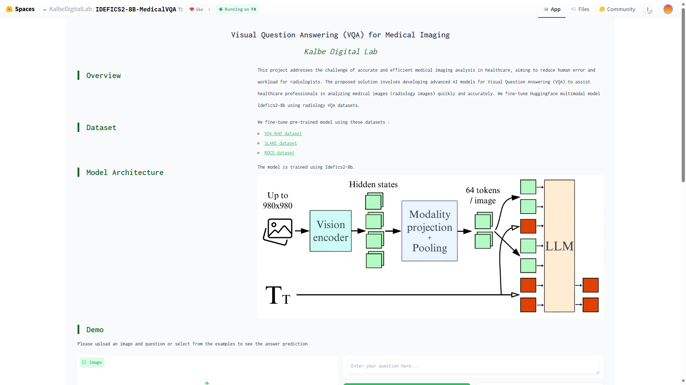
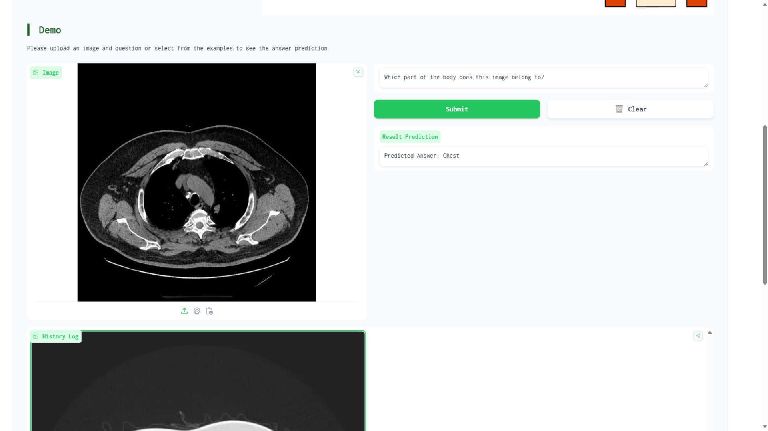
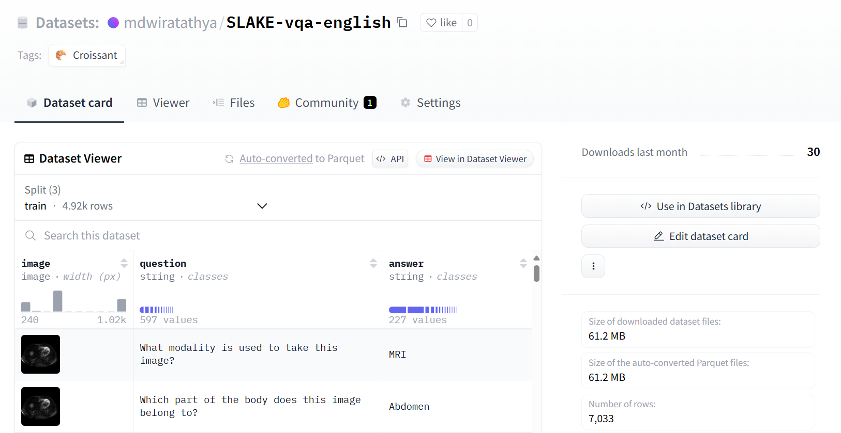
Documentation
C24-RM01
VQA for Medical Imaging
12
https://github.com/Kalbe-x-Bangkit/C24-RM-Kalbe-Bangkit

Slide 14
Development Plan - Timeline
C24-RM01
VQA for Medical Imaging
13
Month 1
Month 2
Month 3
Requirement gathering
Paper review (state of the art)
Reproduce SOTA model
GUI development for VQA
Model training with different modality datasets
Model deployment to Hugging Face Spaces
Model feedback and evaluation to see the performance of the VQA model
Month 6
Month 5
Month 4
Integration with internal Kalbe Medical Imaging Platform in Huggingface
Continuous feedback and improvement to the model and evaluate the performance
Testing the model with real different modality data
Continuous feedback and improvement to the model
Notes:
Month 1: 1. Requirement gathering
2. Paper review (state of the art)
3. Reproduce SOTA model
Month 2: 1. GUI development
2. Model training
3. Model deployment
Month 3: 1. Model feedback and evaluation
Month 4:
1. Model testing with real data
2. Continuous feedback and improvement
Month 5:
1. Continuous feedback and improvement
Month 6:
1. Integration with internal Kalbe Medical Imaging Platform

Slide 15
Development Plan:
Budgeting and Resources
C24-RM01
VQA for Medical Imaging
14
Categories |  | Duration Month | Budget (IDR)
Resources | Hugging Face Spaces Zero GPU | 6 | 1,627,840
 | Google Colab Pro | 6 | 900,000
 | Google Cloud Platform | 6 | 9,772,770
Total |  |  | 12,300,610
Notes:
personnel/person-hours, tools, expenses, subscriptions, etc

Slide 16
Appendix
Kalbe: Visual Question Answering for Medical Imaging

Slide 17
Idefics2
C24-RM01
VQA for Medical Imaging
15
IDEFICS
Flamingo
Few-Shot Learning
LLaMA
OpenClip
Notes:
Idefics is based on Flamingo, which is used for few shot learning. The goal of few shot learning is not to let the model recognize the images in the training set and then generalize to the test set, but is “learn to learn”. The goal of training is to recognize objects, but to know the similarity and difference between objects.
IDEFICS is adapted from the Flamingo architecture, which combines two frozen models: LLaMA (text, main backbone) & OpenClip (vision)
Major contribution is the preparation of a (very large) OBELICS, multimodal (text & image) web dataset

Slide 18
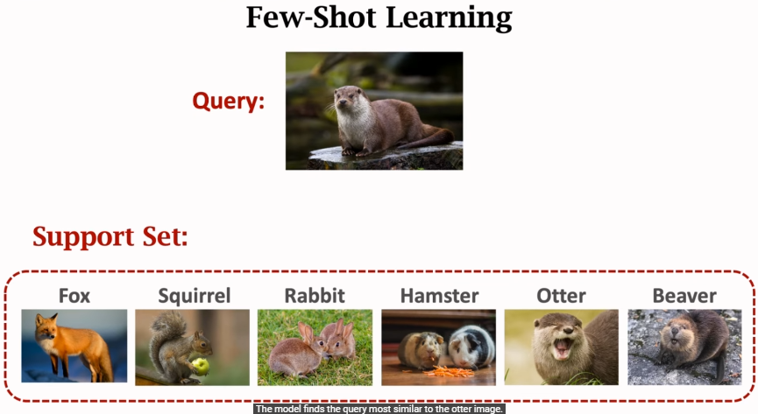
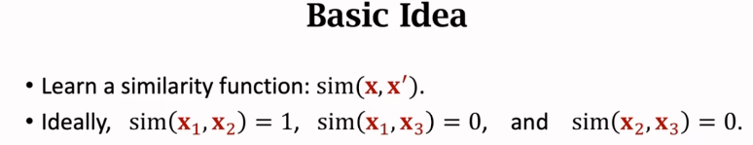
Idefics2
C24-RM01
VQA for Medical Imaging
16
Notes:
Idefics is based on Flamingo, which is used for few shot learning. The goal of few shot learning is not to let the model recognize the images in the training set and then generalize to the test set, but is “learn to learn”. The goal of training is to recognize objects, but to know the similarity and difference between objects.

Slide 19
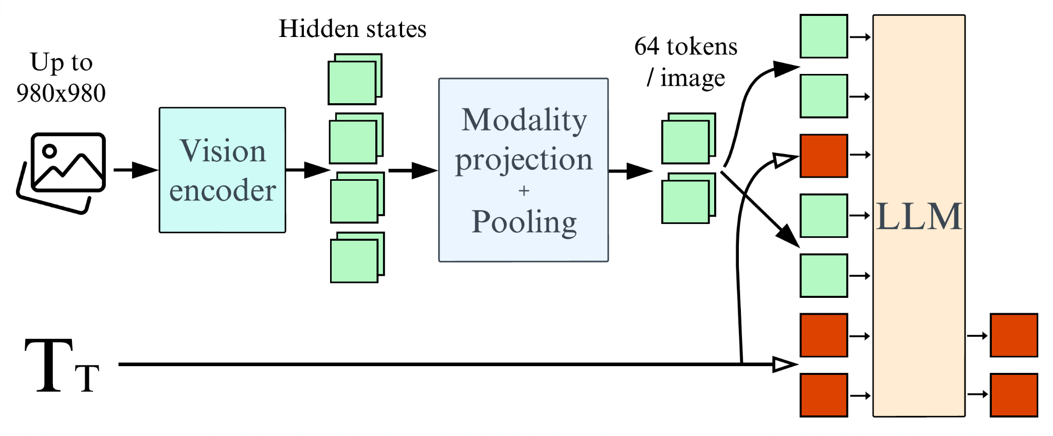
Idefics2 - Architecture
C24-RM01
VQA for Medical Imaging
17
Notes:
Figure 2: Idefics2 fully-autoregressive architecture: Input images are processed by the Vision encoder. The resulting visual features are mapped (and optionally pooled) to the LLM input space to get the visual tokens (64 in our standard configuration). They are concatenated (and potentially interleaved) with the input sequence of text embeddings (green and red column). The concatenated sequence is ... fed to the language model (LLM), which predicts the text tokens output

Slide 20
Idefics2 vs Idefics1
C24-RM01
VQA for Medical Imaging
18
Idefics2 surpasses Idefics1 with 8 billion parameters
The images are manipulated at native resolutions (up to 980 x 980). Aspect ratios using the NaViT strategy
the OCR capabilities have been greatly enhanced with data for transcribing text from images and documents
the architecture is simplified
These enhancements and better pre-trained backbones result in a significant performance boost over Idefics1, even though the new model is 10 times smaller.
IDEFICS2: Multimodal Language Models for the Future (paperspace.com)

